Slide 1
Assessing the Impact of Banning Internal Combustible Engines (ICE) on California Emissions
DATA 621: Fall 2020
Group 3
Zach Alexander, Sam Bellows, Donny Lofland, Joshua Registe, Neil Shah, Aaron Zalki

Slide 2
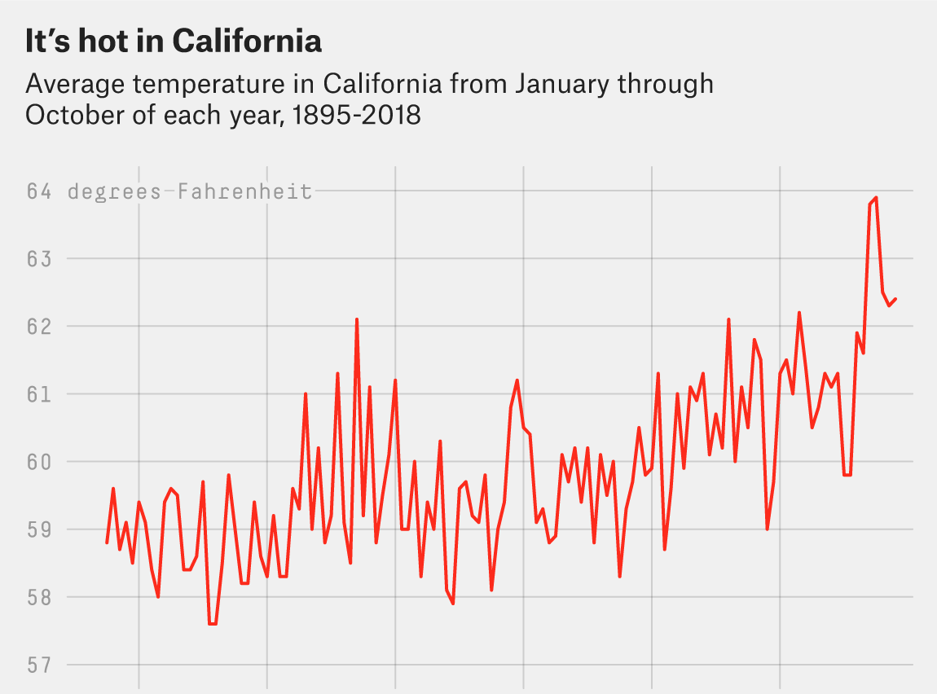
Introduction & Motivation
Climate Change is a top priority in 2020
Economic damage projected trillions per year by 2100
Supported by majority of Americans
California epicenter of climate change
Most populous state
Extreme temperature rises
Propensity for wild-fires

Slide 3
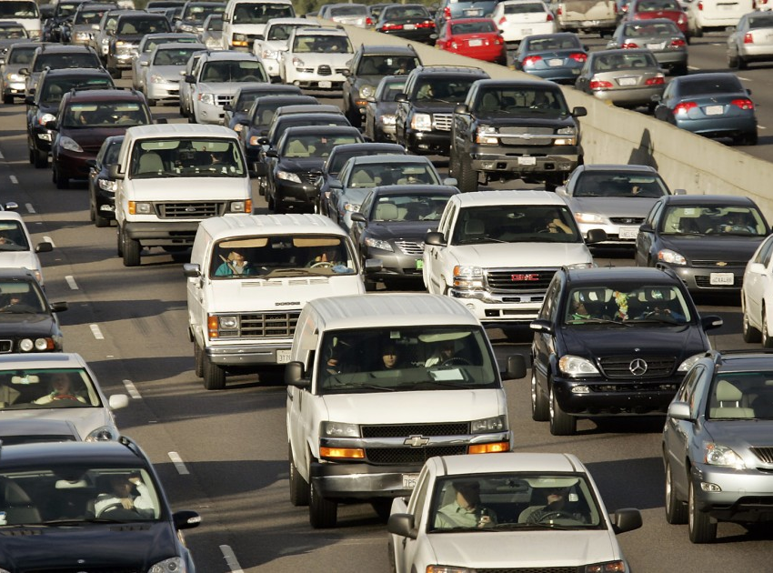
Introduction & Motivation
September 20th, 2020 Governor Newsom bans internal combustible engines (ICE) by 2035; no new sales by 2045
Strongest action by far against climate change
Question
What will be the impacts (quantified) of the ban of gasoline engines do the overall California Emissions?

Slide 4
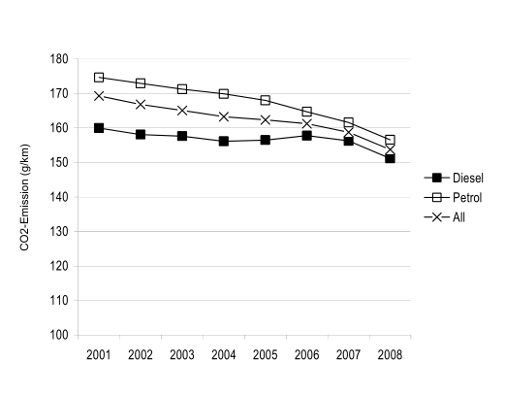
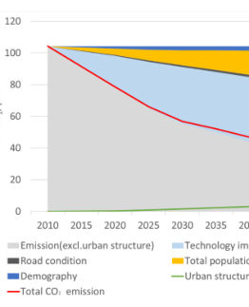
Literature Review
Previous research focused on different representations of vehicle carbon emissions
Theoretical Physical model of vehicle with rolling resistance, friction and other parameters (Fontaras & Panagiota, 2011)
Linear model with factors such as mass, car type, engine or fuel (G. Mellios, 2011)
Aggregate systems of traffic (multiple cars) as a stream (Kevin R. Gurney, 2012)
Traffic dynamics involving changing population (Kii, 2020)

Slide 5
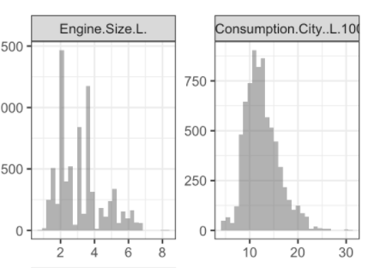
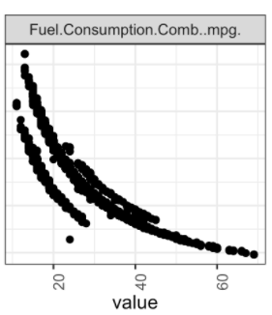
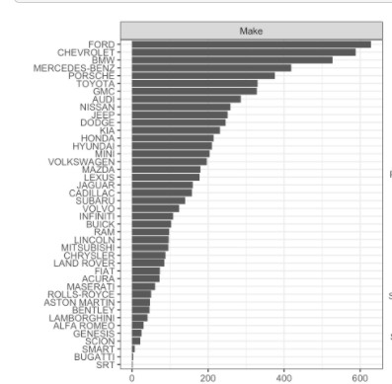
Exploratory Data Analysis
Generated distribution on categorical and numerical features
Engine Size [Displacement]
Fuel Economy
Make of Vehicle
Class of Vehicle [SUV, Compact Mid-Size, etc]
Type of Transmission
Number of Cylinders

Slide 6
References
Full GitHub Repo: https://github.com/djlofland/DS621_F2020_Group3/tree/master/Final%20Project
Christie Aschwanden, A. M.-J. (2018, November 16). Why California’s Wildfires Are So Destructive, In 5 Charts. Retrieved from 538: https://fivethirtyeight.com/features/why-californias-wildfires-are-so-destructive-in-5-charts/
Fontaras, G., & Panagiota, D. (2011). The evolution of European passenger car characteristics 2000–2010 and its effects on real-world CO 2 emissions and CO 2 reduction policy . Energy Policy.
G. Mellios, S. H. (2011). Parameterisation of fuel consumption and CO 2. JRC Scientific and Technical Reports.
Hope, C., & Alberth, S. (2008). The Cost of Climate Change: What We’ll Pay if Global Warming. NRDC.
J.A. Paravantis *, D. G. (2006). Trends in energy consumption and carbon dioxide emissions. Technology in Forecasting and Societal Change.
Kevin R. Gurney, I. R. (2012). Quantification of Fossil Fuel CO 2 Emissions on the Building/Street. Environmental Science and Technology.
Kii, M. (2020). Reductions in CO 2 Emissions from Passenger Cars in Japan under Population and Technology. Sustainability .
Nadia, P. (2020, Feb 20). Climate Change Rises as a Public Priority. But It’s More Partisan Than Ever. Retrieved from New York Times: https://www.nytimes.com/interactive/2020/02/20/climate/climate-change-polls.html
Newsom, G. (2020, September 23). Executive Department State of California: N-79-20. Retrieved from https://www.gov.ca.gov/wp-content/uploads/2020/09/9.23.20-EO-N-79-20-Climate.pdf
Rust, S., & Barboza, T. (2020, September 13). How Climate Change is fueling record-breaking California wildfires, heat and smog. Retrieved from Los Angeles Times : https://www.latimes.com/california/story/2020-09-13/climate-change-wildfires-california-west-coast
Tabuci, H. (2018, April 2). New York Times. Retrieved from Calling Car Pollution Standards ‘Too High,’ E.P.A. Sets Up Fight With California: https://www.nytimes.com/2018/04/02/climate/trump-auto-emissions-rules.html
Toshiko, N. (2003). Energy Modeling on Cleaner Vehicles in Japan. Journal of Cleaner Production.

